Slide 1
CREATING A VIRTUAL GEOGRAPHIC LEARNING ENVIRONMENT AND ITS USER ASSESSMENT
Guldariya KURBONOVA
Supervisor: Dr. Stanislav POPELKA | Palacky University Olomouc
Co-Supervisor: Prof. Dr. Bernd RESCH Assoc. Prof. | University of Salzburg

Slide 2
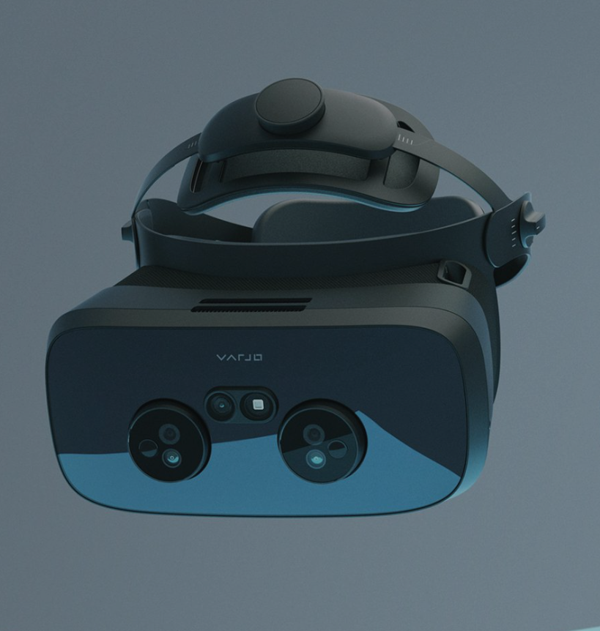
INTRODUCTION
OBJECTIVES
Melting of Glaciers
Melting of Ice Sheets
Sea Level Rise
Traditional Media vs Virtual Reality
Immersive Experience
Better Understanding
Development of a Virtual Learning Environment with Geographic Content
Perform its User Assessment using Eye-tracking
OUTPUTS
the final version of the virtual learning environment
general insights about this environment
the description of how to create virtual learning environment
the method of analyzing eye-tracking data from virtual reality
VARJO XR-3

Slide 3
5 geographic learning contents were chosen: - ESTEC - Falcon 9 Rocket - Copernicus Sentinel-6 Michael Freilich satellite - Visualization of Sea Surface Temperature trends - Venice city, Italy
Literature Review
COPERNICUS MUSEUM

Slide 4
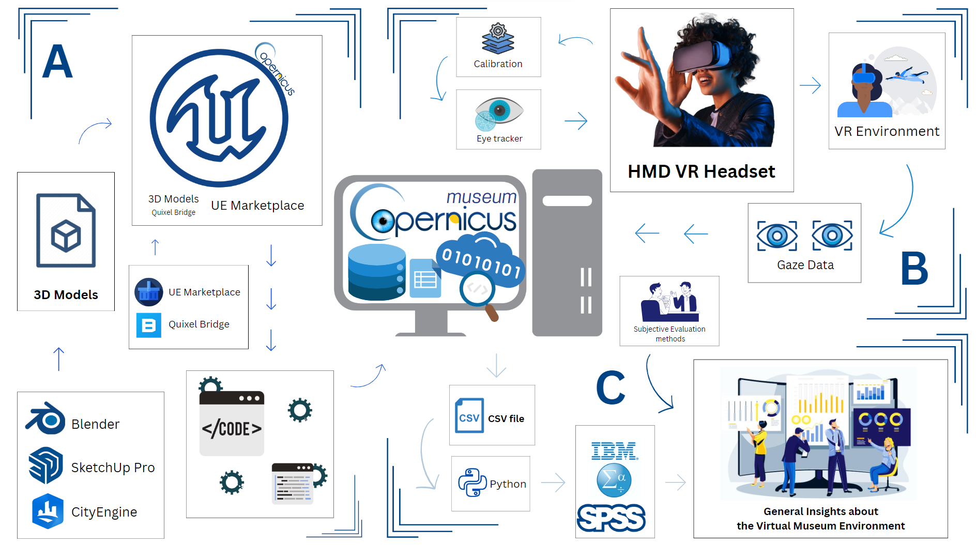
METHODOLOGY
Section A focuses on the Development of the Virtual Geographic Environment. This environment was then connected to a VR headset using Blueprint Visual Scripting system
Section B examines the collecting Eye-tracking Data
Section C details the workflow for analyzing the data obtained from the Virtual Environment.

Slide 5
FINAL VERSION OF THE COPERNICUS MUSEUM IMMERSIVE VIRTUAL GEOGRAPHIC LEARNING ENVIRONMENT

Slide 6
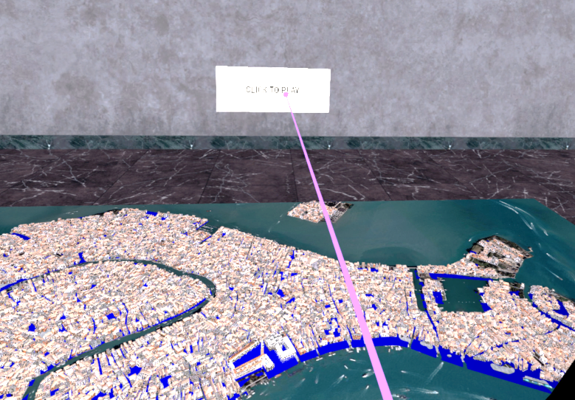
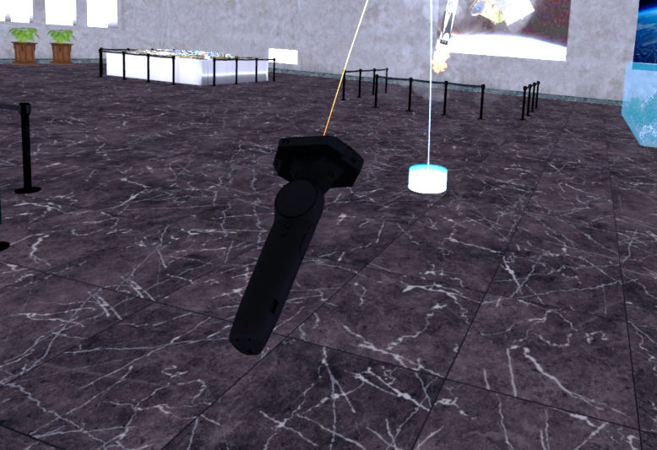
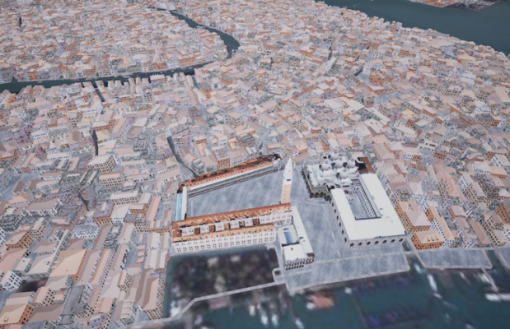
museum
3
1
2
Falcon 9 Rocket
Copernicus Sentinel-6 Michael Freilich satellite
ESTEC
Video Playback Controller
4
Visualization of Sea Surface
Temperature trends
5
Venice city, Italy
Teleportation

Slide 7
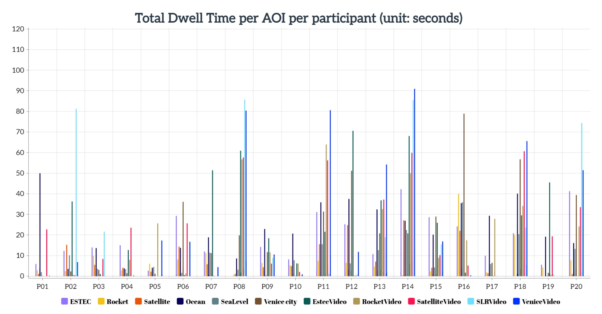
INSIGHTS FROM EYE-TRACKING EXPERIMENT
VISUAL ATTENTION
Visual Intake
Total Dwell Time
participants P08, P11, P14, P18, and P20 allocated a greater amount of time to watching videos

Slide 8
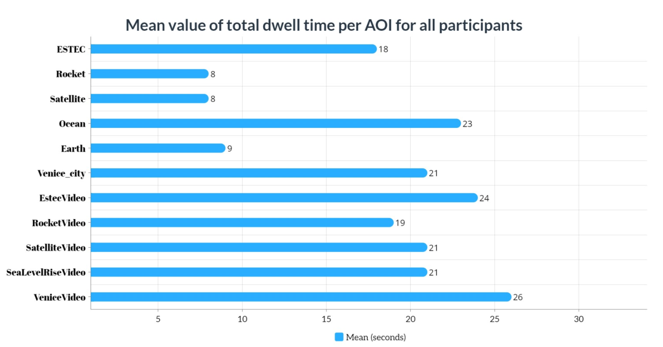
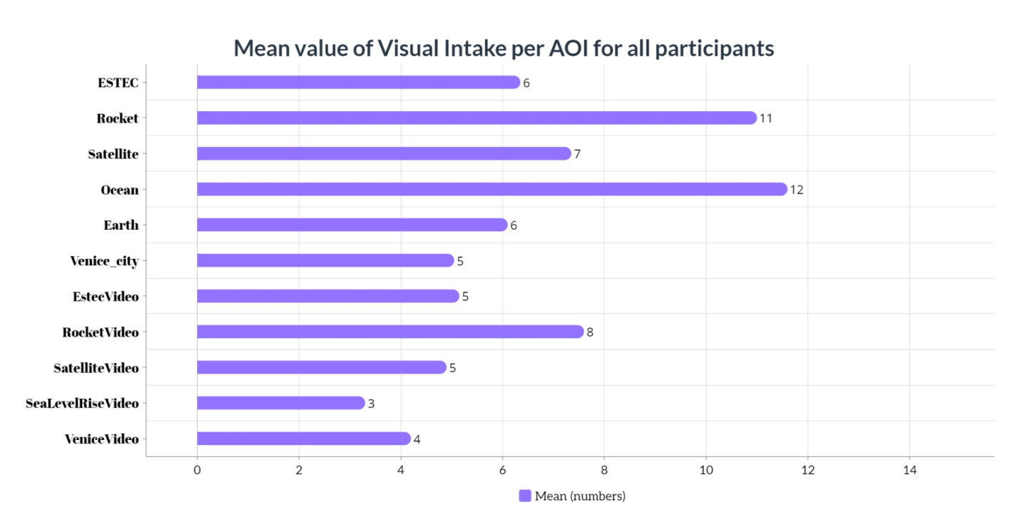
Distribution of Visual Attention per AOIs
VeniceVideo exhibit had the highest mean value (M = 25.50; SD = 31.89)
Rocket exhibit had the lowest mean value (M = 7.59; SD = 8.83)
The mean values for the remaining AOIs varied from 8.12 (Satellite) to 24.39 (EstecVideo)
These findings indicate that the content and presentation of different exhibits play a crucial role in directing users' visual attention
Ocean exhibit had the highest mean value (M = 11.60; SD = 4.46)
SeaLevelRiseVideo exhibit recorded the lowest mean value (M = 3.30, SD = 2.99)
Among the other AOIs, the mean values varied from 11.00 (Rocket) to 4.20 (VeniceVideo)
These findings highlight the varying levels of engagement participants had with different exhibits. Factors such as the relevance, complexity, and visual appeal of the exhibits may have influenced the overall visual attention

Slide 9
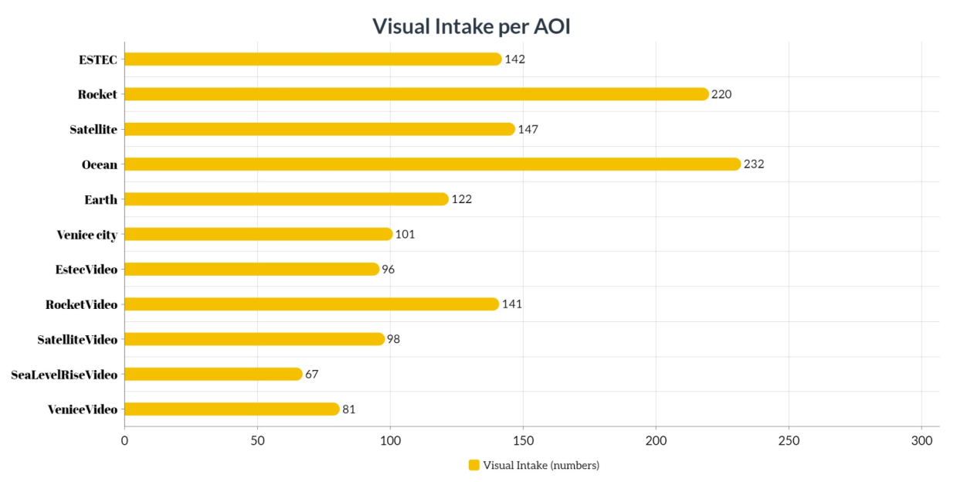
Visual Intake per AOI
The Ocean exhibit received the highest number of VI
The exhibits of Rocket and Satellite also received significant attention
This suggests that participants found the Ocean, Rocket, and Satellite exhibits particularly intriguing and appealing to visit
Participant Demographics
Demographic Characteristics | Parameters | No. of Participants (%)
Total no. of Participants |  | 20 (100%)
Gender | Male | 8 (40%)
 | Female | 12 (60%)
Age | 18-28 | 10 (50%)
 | 29-59 | 10 (50%)
Previous VR Experience | Yes | 11
 | No | 9

Slide 10
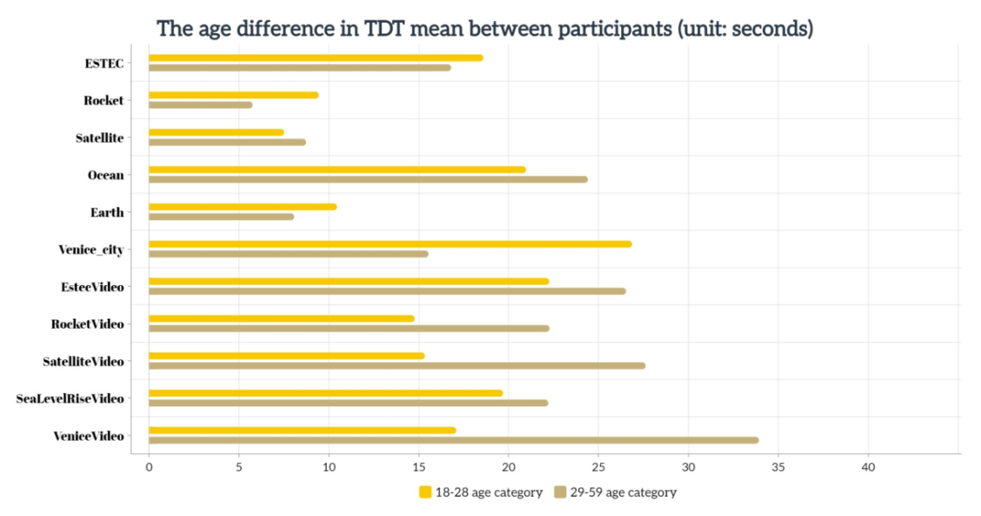
Gender & Age Differences in Visual Attention
Gender Differences in Visual Attention
the t-test results comparing gender revealed notable differences in TDT at the ESTEC exhibit (t = 1.538)
the mean values for male and female participants were 22.65 and 14.40 seconds, respectively
this suggests that, on average, male participants showed a greater interest in the ESTEC exhibit compared to female participants
the t-test results on the VI at ESTEC showed a slight difference (t = 0.841)
the mean values for male and female participants were 7.38 and 5.67 seconds, respectively
thus, the mean interest level of male participants in the ESTEC exhibit was higher than female participants
These gender differences suggest that personal preferences and interests can influence visual attention and engagement with specific exhibits within the VR environment
The participants in the 29-59 age category had a higher mean value of TDT for VeniceVideo compared to the 18-28 age category, with mean values of 33.92 and 17.09, respectively
Specifically, videos highlighting exhibits in the Virtual Museum had a higher mean value within the 29-59 age category
In contrast, the 18-28 age category showed a higher mean value for dynamic exhibits such as Rocket and Earth
These age-related differences suggest that different age groups
may have distinct preferences and interests when exploring
virtual exhibits

Slide 11
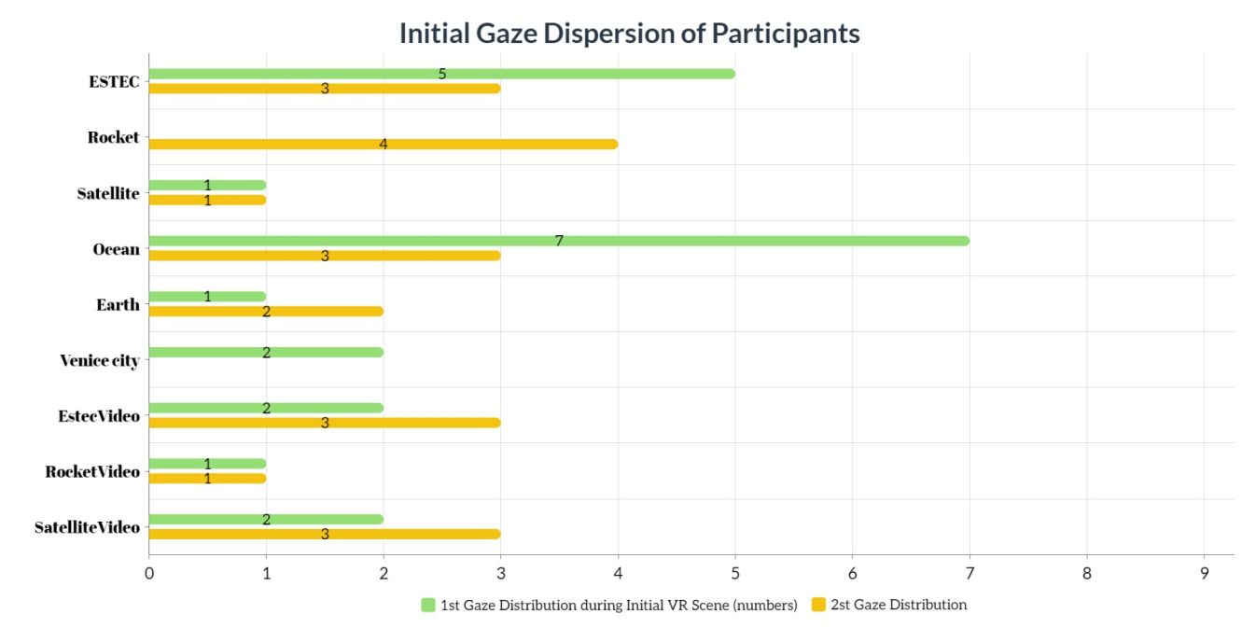
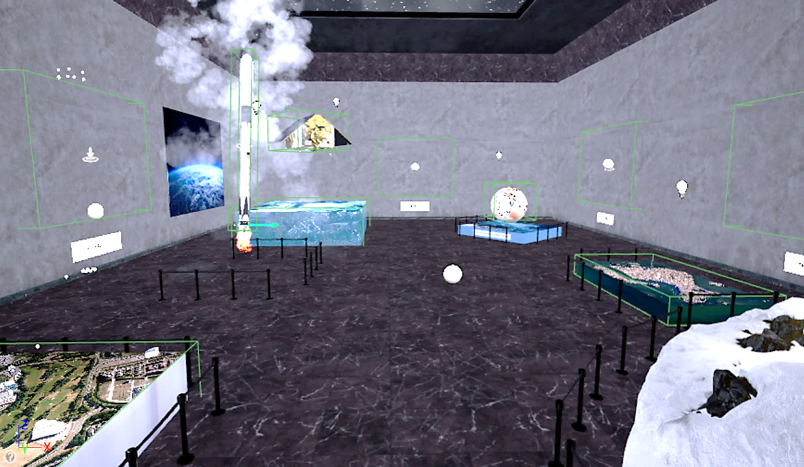
Initial Gaze Scatter and Exhibit Order
Out of the participants, 7 looked on the Ocean while 5 looked on ESTEC initially.
The exhibits within the COPERNICUS MUSEUM were carefully arranged in a particular order.
The exhibits followed a specific sequence: ESTEC, Falcon 9 rocket,
Sentinel-6 satellite, Ocean, Globe, and Venice city.
The participants were expected to begin their exploration from ESTEC and proceed to the Rocket
This finding served as evidence that participants
were provided with subtle hints or guidance
regarding the direction
PARTICIPANT
Starts from HERE

Slide 12
Subjective Insights
Subjective insights on which exhibits within the VE were stood out
participants were particularly drawn to the exhibit featuring a Rocket model
the models depicting marine life (Ocean) and the city of Venice garnered high attention and interest from the participants
Participants provided suggestions for improving the VR Museum experience, such as adjusting video sizes for better viewing and providing clearer guidance for navigating through the exhibits.
VR museum vs traditional physical museum experience
Notable responses included the following perspectives:
“VR is the future and a good investment.”
“The VR museum is new.”
“VR is good in terms of bringing scenes that do not exist.”
“The advantages of VR include bringing information on different topics into one place. For example, I was able to explore Arctic and Venice city models, and I felt like they were right in front of me, allowing me to thoroughly explore them.”
“The purposes of VR and physical museums are different.”
“The VR environment is not crowded.”
“VR is more interactive than the physical museum experience.”
Participants were asked to rate the level of realism and immersion they experienced in the COPERNICUS MUSEUM environment.
Using a rating scale from 1 to 5, with 5 being the highest rating, the participants' average rating was 3.7.
This indicates that participants generally found the
COPERNICUS MUSEUM environment to be
immersive and realistic, with a high level of
engagement and authenticity

Slide 13
CONCLUSION
The final version of the virtual learning environment was developed
Profound and invaluable insights regarding this environment were acquired
The comprehensive description of the procedures for creating the virtual learning
environment was successfully accomplished
A proficient demonstration was conducted on the method of analyzing eye-tracking data within the context of virtual reality
This study contributes to the ongoing advancement of geographic education and serves as a foundation for the creation of innovative educational platforms.
The findings underscore the importance of utilizing eye-tracking technology to gain deeper
insights into user behavior and preferences, enabling educators to create more engaging
and interactive learning environments.

Slide 14
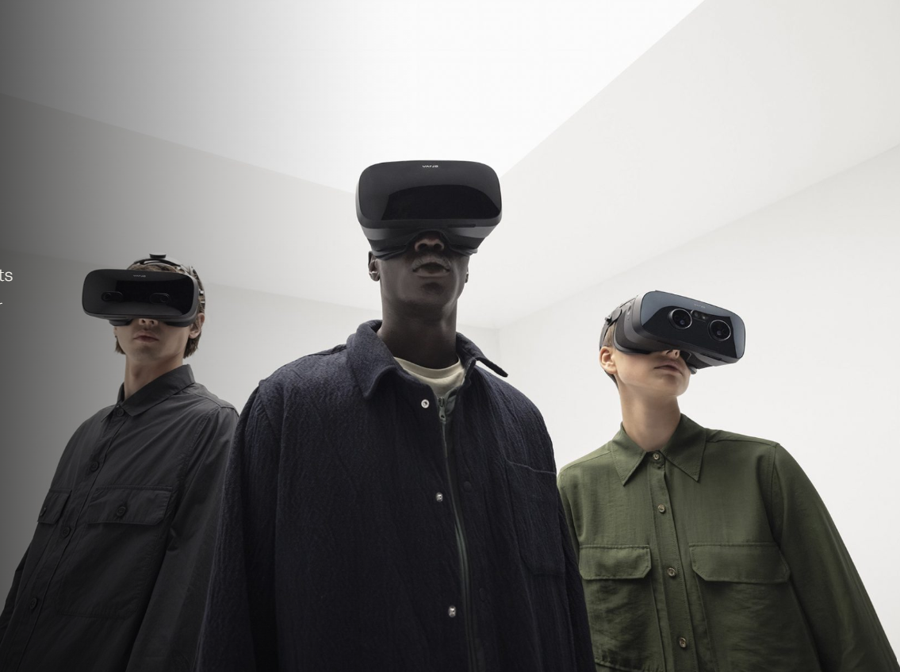
Thanks!

